Slide 1
Networks Fundamentals
Mousa Al-Sahory

Slide 2
Chapter 3
Network Types
Network Topology

Slide 3
Network Fundamentals
Network Types
3

Slide 4
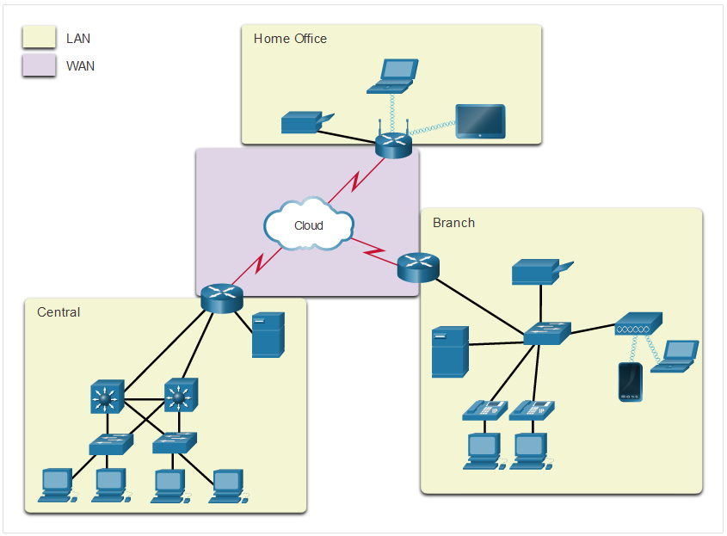
Common Types of Networks LANs and WANs
Network Types
Network infrastructures vary greatly in terms of:
Size of the area covered
Number of users connected
Number and types of services available
Area of responsibility
Notes:
1 – Networking Today
1.4 – Common Types of Networks
1.4.2 – LANs and WANs

Slide 5
Network Types
Primary types of communications networks
Wide Area network
Local Area network
Metropolitan Area network
Virtual Private network
Client-Server network
Peer-to-peer network
Wireless networks

Slide 6
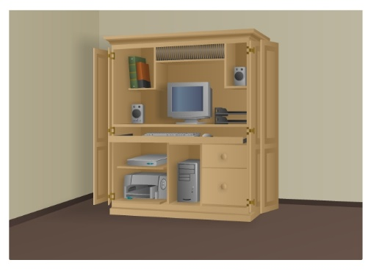
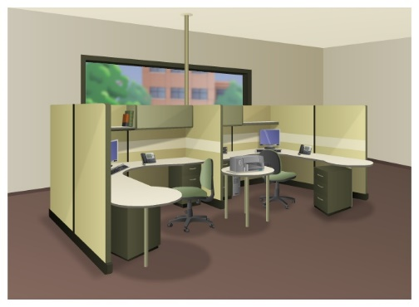
Common Types of Networks Networks of Many Sizes
Network Types
Small Home Networks – connect a few computers to each other and the Internet
Small Office/Home Office – enables computer within a home or remote office to connect to a corporate network
Small Home SOHO
Notes:
1 – Networking Today
1.4 – Common Types of Networks
1.4.1 – Networks of Many Sizes

Slide 7
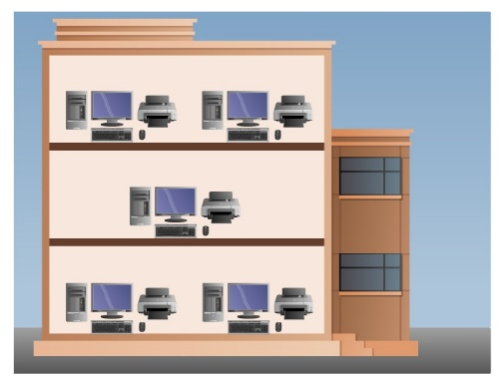
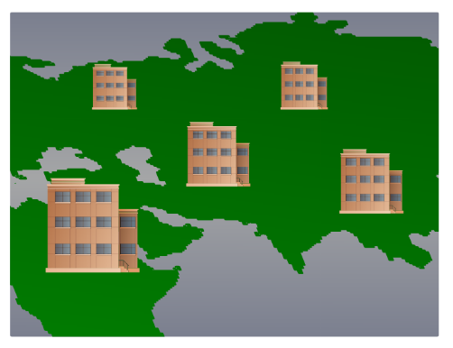
Common Types of Networks Networks of Many Sizes
Network Types
Medium to Large Networks – many locations with hundreds or thousands of interconnected computers
World Wide Networks – connects hundreds of millions of computers world-wide – such as the internet
Medium/Large World Wide
Notes:
1 – Networking Today
1.4 – Common Types of Networks
1.4.1 – Networks of Many Sizes

Slide 8
Local Area Network (LAN)
A local area network is a communication network that interconnects a variety of data communicating devices within a small geographic area and broadcasts data at high data transfer rates
A network serving a home, building or campus is considered a Local Area Network (LAN)
Since the local area network first appeared in the 1970s, its use has become widespread in commercial and academic environments
8

Slide 9
Local Area Network (LAN)
To provide access to hardware and software resources that will allow users to perform one or more of the following activities:
Access to the Internet
File serving
A large storage disk drive acts as a central storage repository
Print serving
Providing the authorization to access a particular printer, accept and queue print jobs, and providing a user access to the print queue to perform administrative duties
Database and application serving
9

Slide 10
Local Area Network (LAN)
Connects computers within a limited physical area, such as an office, classroom, or building
To provide access to hardware and software resources that will allow users to perform one or more of the following activities (continued):
Manufacturing support
LANs can support manufacturing and industrial environments
Academic support
In classrooms, labs, and wireless
E-mail serving
Interconnection between multiple systems

Slide 11
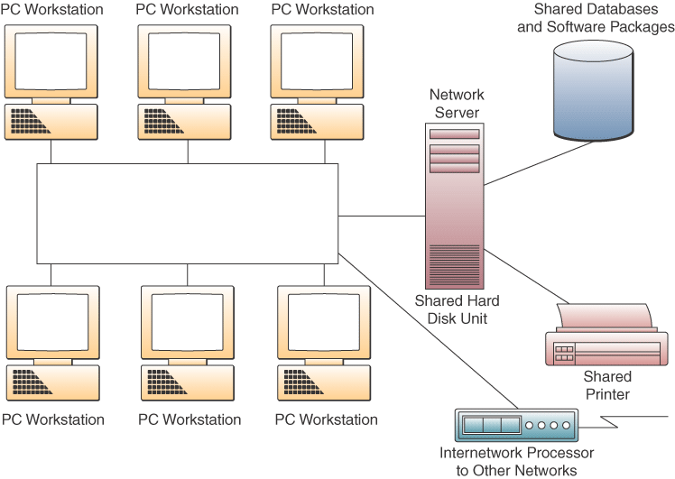
Local Area Network (LAN)

Slide 12
Local Area Network (LAN)
Advantages
Ability to share hardware and software resources
Component and system evolution are possible
Support for heterogeneous forms of hardware and software
Access to other LANs and WANs
Secure transfers at high speeds with low error rates
Disadvantages
Equipment and support can be costly
Level of maintenance continues to grow
Some types of hardware may not interoperate

Slide 13
Local Area Network (LAN)
13

Slide 14
Virtual LANs
Virtual LAN (VLAN) – logical subgroup within a LAN that is created via switches and software rather than by manually moving wiring from one network device to another.
Even though employees and their actual computer workstations may be scattered throughout the building, LAN switches and VLAN software can be used to create a “network within a network”
VLAN: Group of devices on one or more LANs that are configured so that they can communicate as if they were attached to the same wire, when in fact they are located on a number of different LAN segments.

Slide 15
Virtual LANs
A relatively new standard, IEEE 802.1Q, was designed to allow multiple devices to intercommunicate and work together to create a virtual LAN.
Instead of sending technician to a wiring closet to move a workstation cable from one switch to another, an 802.1Q-compliant switch can be remotely configured by a network administrator .
In simple words VLAN is a logical partition of a Layer 2 network.
Each VLAN is a broadcast domain, usually with its own IP network.

Slide 16
VLAN Definitions
VLAN Definitions
VLANs are mutually isolated and packets can only pass between them via a router
The hosts grouped within a VLAN are unaware of the VLAN’s
existence.
A VLAN can be named for easier identification
Different VLANs should have:
Different VLAN IDs.
Different VLAN Names.

Slide 17
VLAN Definitions

Slide 18
VLAN Definitions
VLAN Definitions

Slide 19
Benefits of VLANs
Benefits of VLANs
Security
Cost reduction
Better performance
Improved IT staff efficiency
Simpler project and application management
Physical topology independence

Slide 20
Wide Area Network (WAN)
LANs separated by geographic distance are connected by a network known as a Wide Area Network (WAN)
20

Slide 21
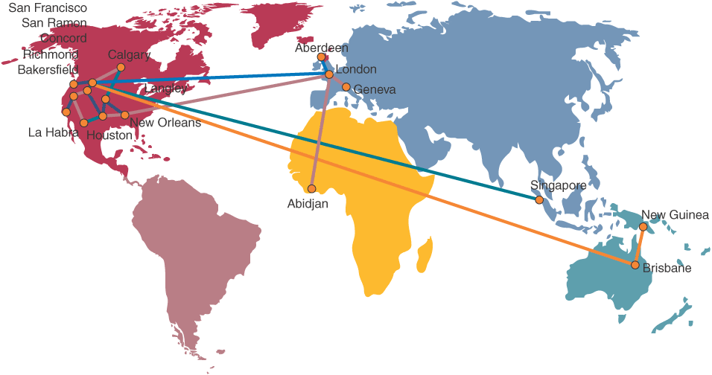
Wide Area Network (WAN)
Telecommunication network that covers a large geographic area

Slide 22
Wide Area Networks (WANs)
22

Slide 23
Metropolitan Area Network (MAN)
A metropolitan area network (MAN) is a hybrid between a
LAN and a WAN.
It connects two or more LANs in the same geographic area
MANs provide high-speed connections, such as
(1.544Mbps) and optical services.
Devices used to provide connections for MANs include high-
routers, switches.
23

Slide 24
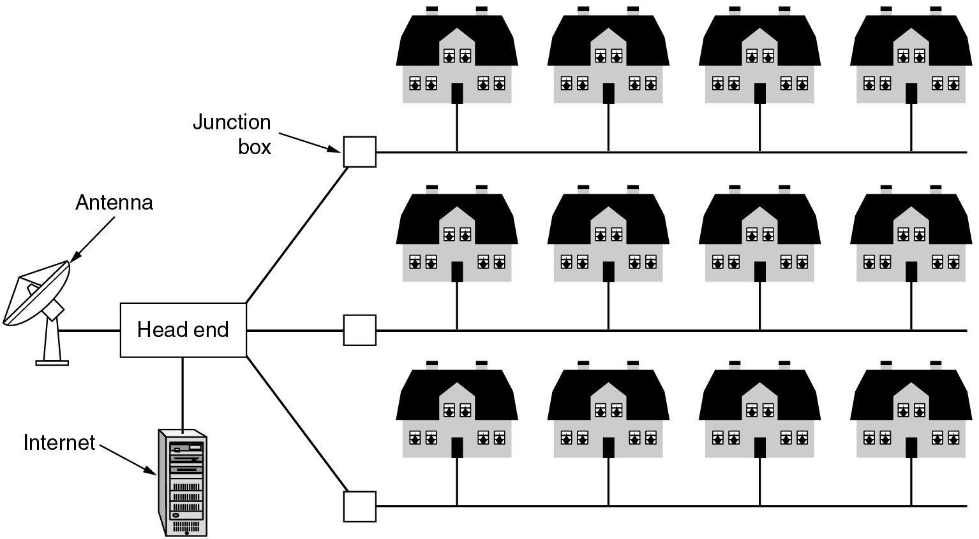
Metropolitan Area Network (MAN)
A metropolitan area network based on cable TV.
24

Slide 25
The Internet
The internet is defined as a global mesh of interconnected networks
25

Slide 26
Virtual Private Network (VPN)
A VPN is a private network that is constructed within a public network infrastructure such as the global Internet.
Using VPN, a telecommuter can access the network of the company headquarters through the Internet by building a secure tunnel between the telecommuter’s PC and a VPN router in the headquarters.

Slide 27
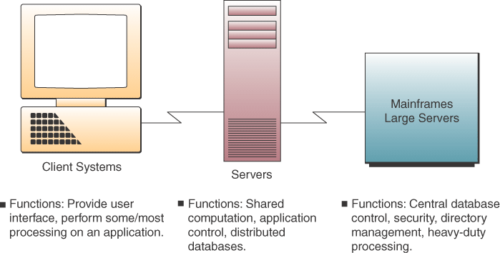
Client- Server Networks
Clients
End user personal computers or networked computers
Servers
Used to manage the networks
Processing
Shared between the clients and servers
Sometimes called a two-tier architecture

Slide 28
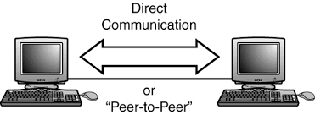
Peer-to-Peer Networks
Central Server Architecture
P2P file-sharing software connects all PCs to a central server
When a PC requests a file, the server searches all active peers on the network.
The server sends the requesting PC a list of links to all active peers who have the file.
Clicking a link connects the two PCs and automatically transfers the file to the requesting PC.

Slide 29
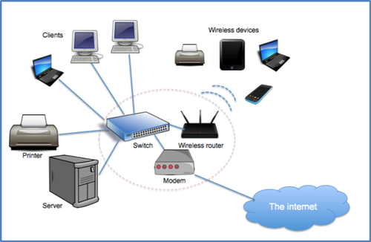
Wireless networks
In wireless network there are no wires between hosts and servers.
The data is transferred over sets of radio transceivers.
The most common wireless networks cover ranges from hundreds of meters to a few kilometers.

Slide 30
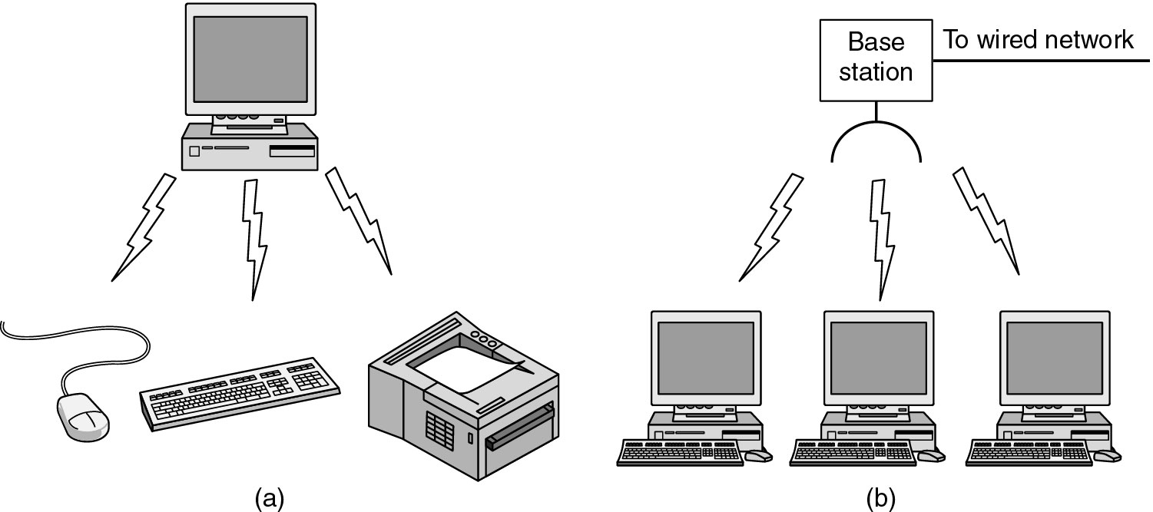
Wireless Networks (2)
Wireless networks
(a) Bluetooth configuration
(b) Wireless LAN

Slide 31
Wireless Networks (2)
Wireless networks
(a) Individual mobile computers
(b) A flying LAN

Slide 32
Network Fundamentals
Network Topology
32

Slide 33
Physical topology of computer networks:
The physical topology of a network refers to the configuration of cables, computers, and other peripherals.
The physical topologies used in networks:
Linear Bus
Star
Ring
Mesh
Hybrid

Slide 34
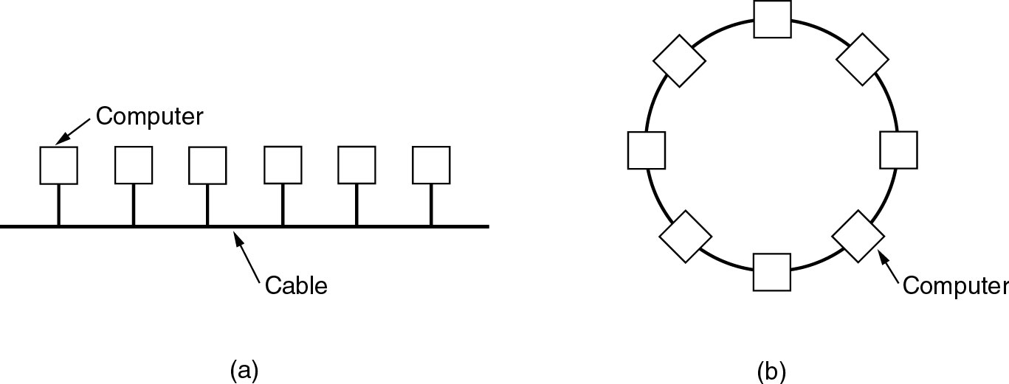
Local Area Networks
Physical topology of computer networks:

Slide 35
Physical Topologies
Physical topology of computer networks:

Slide 36
Linear Bus topology:
In linear bus computers are connected to a common line of information and this common line is called a bus, so it is called a bus topology. A linear bus topology consists of a main run of cable with a terminator at each end . All computers are connected to the linear cable.
A bus topology uses a single backbone cable that is terminated at both ends.
All the hosts connect directly to this backbone.

Slide 37
Linear Bus topology:
Advantages of a Linear Bus Topology
Easy to connect a computer or peripheral to a linear bus.
Requires less cable length than a star topology.
Disadvantages of a Linear Bus Topology
Entire network shuts down if there is a break in the main cable.
Terminators are required at both ends of the backbone cable.
Difficult to identify the problem if the entire network shuts down.
Not meant to be used as a stand-alone solution in a large building.

Slide 38
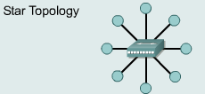
Star topology
A star topology is designed with each node (file server, workstations, and peripherals) connected directly to a central network hub
Data on a star network passes through the hub before continuing to its destination. The hub or concentrator manages and controls all functions of the network.. This configuration is common with twisted pair cable; however, it can also be used with coaxial cable or fiber optic cable.

Slide 39
Star topology
Advantages of a Star Topology
Easy to install and wire.
No disruptions to the network then connecting or removing devices.
Easy to detect faults and to remove parts.
Disadvantages of a Star Topology
Requires more cable length than a linear topology.
If the hub or concentrator fails, nodes attached are disabled.
More expensive than linear bus topologies because of the cost of the concentrators.
A star topology connects all cables to a central point of concentration.

Slide 40
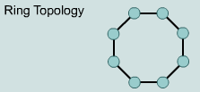
Ring Topology
All computers in the network are connected in a closed loop.
The ring topology is actually a logical ring, meaning that the data travels in circular fashion from one computer to another on the network. It is not a physical ring topology.
A ring topology connects one host to the next and the last host to the first.
This creates a physical ring of cable.

Slide 41
Ring Topology
Advantages of Ring topology
Cable faults are easily located, making troubleshooting easier
Ring networks are moderately easy to install.
Every computer in the ring gets equal opportunity to send its data, and no computer can dominate the network.
Disadvantages of Ring topology
Expansion to the network can cause network disruption.
A single break in the cable can disrupt the entire network
Slow performance of the network, when more computers are added.
If one computer fails, the entire network goes down.
Its troubleshooting is difficult, and addition or removal of any computer can disrupt the entire network.

Slide 42
Mesh topology :
. In a mesh topology, each computer on network has redundant data paths to other computers.
A mesh topology is most often used in large backbone networks in which failure of a single switch or router can result in a large portion of the network going down
Mesh topology

Slide 43
Mesh topology :
Advantages of Mesh topology
Mesh networks are "self-healing" - if a node goes down the data takes another path.
Relatively inexpensive to cover a large area.
Disadvantages of Mesh topology
Routing network traffic can be difficult because of all the different possible paths between nodes.
No central infrastructure (the network relies on peer-to-peer connections).
A mesh topology is implemented to provide as much protection as possible from interruption of service.
Each host has its own connections to all other hosts. Although the Internet has multiple paths to any one location, it does not adopt the full mesh topology.

Slide 44
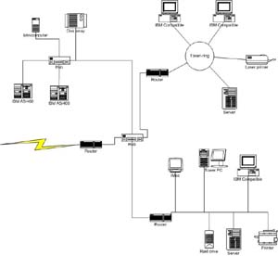
Hybrid topology
:
Hybrid network is the combination of different topologies such as star, Ring, Mesh, Bus etc. All the networks of different types (can be connected together through a central hub (in the form of star network).
Hybrid topology

Slide 45
Q&A

